Slide 1
CS5560 Knowledge Discovery and Management Lecture 4 Information Retrieval (TF-IDF,Word2Vec)

Slide 2
Workflow
Text
data
NLP
TF-IDF
Word2Vec
Significant
Terms
LDA
Relation
Extraction
Synonym
Relations
Topic
Name Entity
Extraction
Name
Feature Vector
Ontology
Learning

Slide 3
Information Retrieval
Text corpus with many documents (docs)
Given a query, find relevant docs
Classical problems:
synonymy: missing docs with reference to “automobile” when querying on “car”
polysemy: retrieving docs on internet when querying on “surfing”
Solution: Represent docs (and queries) by their underlying latent concepts

Slide 4
Information Retrieval
Word
A word is an item from a vocabulary indexed by {1,…,V}. Which is represented as unit-basis vectors. The vth word is represented by a V-vector w such that only the vth element is 1, while the others are 0
Document
- A document is a sequence of N words denoted by w = {w1, w2 , … , wN}, where wi is the ith word in the sequence.
Corpus
- A corpus is a collection of M documents, denoted by D = {w1, w2 , … , wM}

Slide 5
Information Retrieval
Represent each document as a word vector
Represent corpus as term-document matrix (T-D matrix)
A classical method:
Create new vector from query terms
Find documents with highest dot-product

Slide 6
Vector Space Model: Query-Document Matching Scores
We need a way of assigning a score to a query/document pair
Let’s start with a one-term query
If the query term does not occur in the document: score should be 0
The more frequent the query term in the document, the higher the score (should be)
We will look at a number of alternatives for this.
Notes:
To improve soundness, we should return documents (let them have non-zero scores) that refer to the same concept implied by the one-term query

Slide 7
Jaccard Coefficient
Jaccard coefficient is a commonly used measure of overlap of two sets A and B
jaccard(A,B) = |A ∩ B| / |A ∪ B|
jaccard(A,A) = 1
jaccard(A,B) = 0 if A ∩ B = 0
A and B don’t have to be the same size.
JC always assigns a number between 0 and 1.

Slide 8
Jaccard Coefficient: Scoring Example
What is the query-document match score that the Jaccard coefficient computes for each of the two documents below?
Query: ides of march
Document 1: caesar died in march
Document 2: the long march
Notes:
JC(1) = 1/6 JC(2) = 1/5

Slide 9
Binary Term-Document Incidence Matrix
Each document is represented by a binary vector ∈ {0,1}^{|V|}
Notes:
V = vocabulary

Slide 10
Issues with Jaccard for Scoring
It doesn’t consider term frequency (how many times a term occurs in a document)
It doesn’t consider document/collection frequency (rare terms in a collection are more informative than frequent terms)
We need a more sophisticated way of normalizing for length
. . . instead of |A ∩ B|/|A ∪ B| (Jaccard) for length normalization.
Notes:
JC: set-based measure : multiplicity and order of words abstracted (immaterial)
TF: casual occurrence vs emphasis (approximate in the face of co-references)
DF/CF: ignore stop words, selective weigh query terms based on their frequencies in the documents/collection
Instead of raw counts, we need relative proportions (cf. within - title vs abstract vs body)
Hack out formula that better reflects the semantics ☺

Slide 11
Term-Document Count Matrices
Consider the number of occurrences of a term in a document
Each document is a count vector in ℕ^{v}: a column below

Slide 12
Term Frequency-Inverse Document Frequency (TF-IDF)
tf-idf (Salton and McGill, 1983)
The term frequency count is compared to an inverse document frequency count.
Results in a txd matrix – thus reducing the corpus to a fixed-length list
Basic identification of sets of words that are discriminative for documents in the collection
Used for search engines

Slide 13
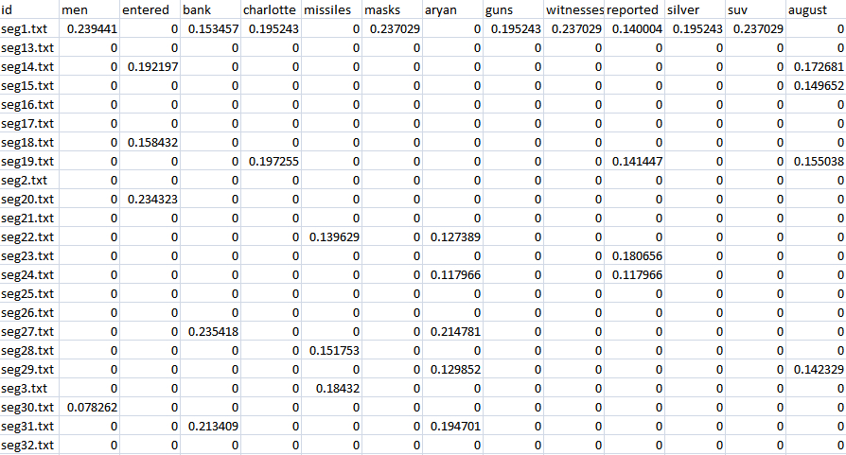
TFIDF Vector (Document/Term)

Slide 14
Term Frequency tf
The term frequency tf_{t,d} of term t in document d is defined as the number of times that t occurs in d.
We want to use tf when computing query-document match scores. But how?
Raw term frequency is not what we want:
A document with 10 occurrences of the term may be more relevant than a document with one occurrence of the term.
But not 10 times more relevant.
Relevance does not increase proportionally with term frequency.
Notes:
Always co-references and document length interferes …
Qualita tive vs quantitative issues

Slide 15
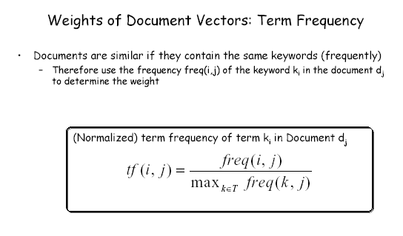
Notes:
An obvious difference that can be made among terms is with
respect to their frequency of occurrence. Thus a weighting
scheme for document weights can be defined by considering the
(relative) frequency of terms within a document. The term
frequency is normalized with respect to the maximal frequency of
all terms occurring in a document.

Slide 16
Example: Term Frequency
Consider three documents
1: a b c a f o n l p o f t y x
2: a m o e e e n n n a n p l
3: r a e e f n l i f f f f x l
First, look at the maximum frequency achieved by any term in a given document.
m_1 = 2 ("a", "f" and "o" are there twice)
m_2 = 4 ("n" is there four times)
m_3 = 5 ("f" is there five times)

Slide 17
Example: Term Frequency (2)
Now look at some example of absolute term frequency
F_a_1 = 2 F_e_2 = 3 F_x_3 = 1
and some examples of relative term frequency
f_a_1 = F_a_1 / m_1 = 2 / 2 = 1
f_e_2 = F_e_2 / m_2 = 3 / 4 = 0.75
f_x_3 = F_x_3 / m_3 = 1 / 5 = 0.2

Slide 18
Log-frequency Weighting
The log frequency weight of term t in d is
0 → 0, 1 → 1, 2 → 1.3, 10 → 2, 1000 → 4, etc.
Score for a document-query pair: sum over terms t in both q and d:
score
The score is 0 if none of the query terms is present in the document.
Notes:
Empherical

Slide 19
Document Frequency
Rare terms are more informative than frequent terms
Recall stop words
Consider a term in the query that is rare in the collection (e.g., arachnocentric)
A document containing this term is very likely to be relevant to the query arachnocentric
We want a higher weight for rare terms like arachnocentric.

Slide 20
Document Frequency, continued
Consider a query term that is frequent in the collection (e.g., high, increase, line)
A document containing such a term is more likely to be relevant than a document that doesn’t, but it’s not a sure indicator of relevance.
For frequent terms, we want positive weights for words like high, increase, and line, but lower weights than for rare terms.
We will use document frequency (df) to capture this in the score.
df (≤ N) is the number of documents that contain the term

Slide 21
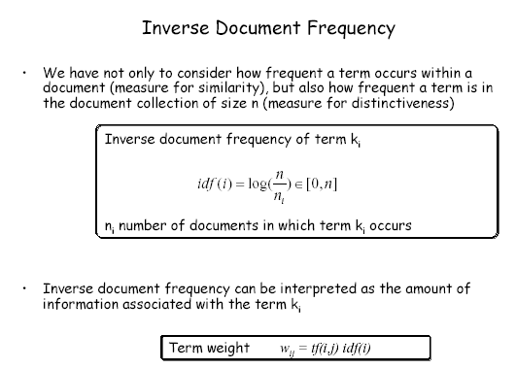
Notes:
Thus we have to take into account not only the frequency of a
term within a document, when determining the importance of the
term for characterizing the document, but also the disambiguating
power of the term with respect to the document collection as a
whole. For that purpose the inverse document frequency is
computed and included into the term weight.
We can see now from this weighting scheme that eliminating
stop words is actually an optimization of computing similarity
measures in vector space retrieval. Since stop words normally
occur in every document of a collection, their term weights will
normally be 0 and thus the terms do not play a role in retrieval.
Thus it is of advantage to exclude them already from the retrieval
process at the very beginning.

Slide 22
Example: Inverse Document Frequency (IDF)
Let N be the number of documents in the database. N=3 in our example.
1: a b c a f o n l p o f t y x
2: a m o e e e n n n a n p l
3: r a e e f n l i f f f f x l
Let n_t be the number of documents where the term t appears. In our example
n_a = 3 n_e = 2 n_x = 2
N/n_t is an indication of inverse document frequency of a term. It is larger the less a term appears across documents in the database. (e.g., ‘e’: log 3/2)

Slide 23
Example: TF & IDF: Term Weight
The final formula for the weight combines the terms as follows
w_t_d = f_t_d * log( N / n_t )
In our example
N = 3, n_a = 3, n_e = 2, n_x = 2
f_a_1 = 1, f_e_2 = 0.75, f_x_3 = 0.2
Weight
w_a_1 = 1* log(3/3) = log(1) = 0
w_e_2 = 0.75 * log(3/2)=0.75*0.176=0.132
w_x_3 = 0.2 * log(3/2)=0.2*0.176 = 0.0352
where log(3/2) = 0.176, approximately

Slide 24
idf weight
df_{t} is the document frequency of t: the number of documents that contain t
df is a measure of the informativeness of t
We define the idf (inverse document frequency) of t by
We use log N/df_{t} instead of N/df_{t} to “reduce” the effect of idf.
Will turn out that the base of the log is immaterial.
Notes:
Empherical

Slide 25
idf example, suppose N = 1 million
term | df_{t} | idf_{t}
calpurnia | 1 | 6
animal | 100 | 4
sunday | 1,000 | 3
fly | 10,000 | 2
under | 100,000 | 1
the | 1,000,000 | 0
There is one idf value for each term t in a collection.

Slide 26
tf-idf Weighting
The tf-idf weight of a term is the product of its tf weight and its idf weight.
Best known weighting scheme in information retrieval
Increases with the number of occurrences within a document
Increases with the rarity of the term in the collection

Slide 27
Binary → Count → Weight Matrix
Each document is now represented by a real-valued vector of tf-idf weights ∈ R^{|V|}

Slide 28
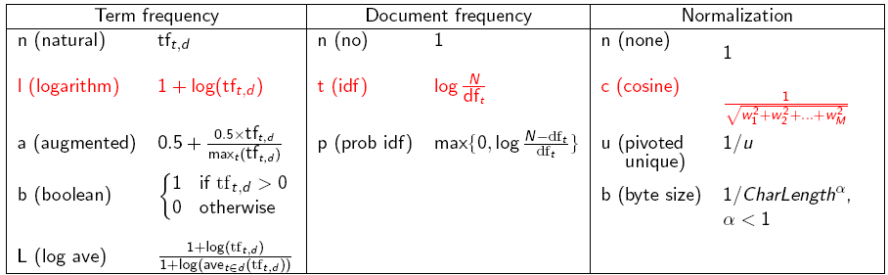
tf-idf Weighting (Variants)
Notes:
max (0, …) because the latter can go negative if (f < df) in (log f/df). That is when (dft ~ N).
The base is immaterial because it only scales the numbers up/down without changing their relative order.

Slide 29
Documents as Vectors
So we have a |V|-dimensional vector space
Terms are axes of the space
Documents are points or vectors in this space
Very high-dimensional: hundreds of millions of dimensions when you apply this to a web search engine
This is a very sparse vector - most entries are zero.

Slide 30
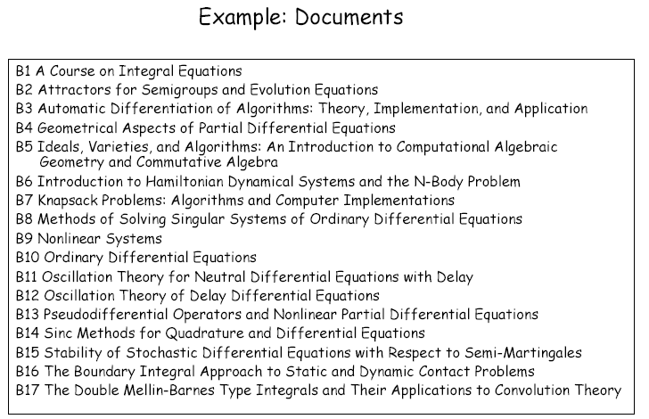
Notes:
This is an example of a (simple) document collection.

Slide 31
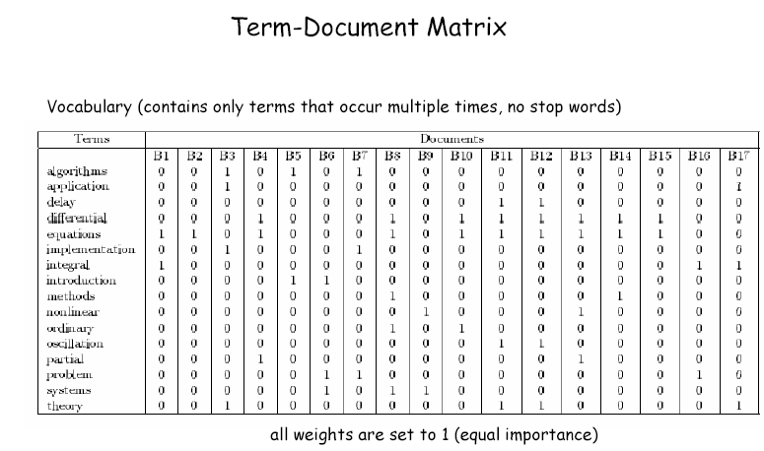
Notes:
In text retrieval we represent the relationship between the index
terms and the documents in a term-document matrix. In this
example only a selected vocabulary is used for retrieval,
consisting of all index terms that occur in more than one
document and only weights 1 are assigned, if the term occurs in
the document.

Slide 32
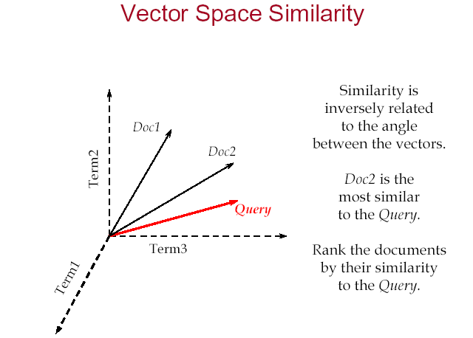

Slide 33
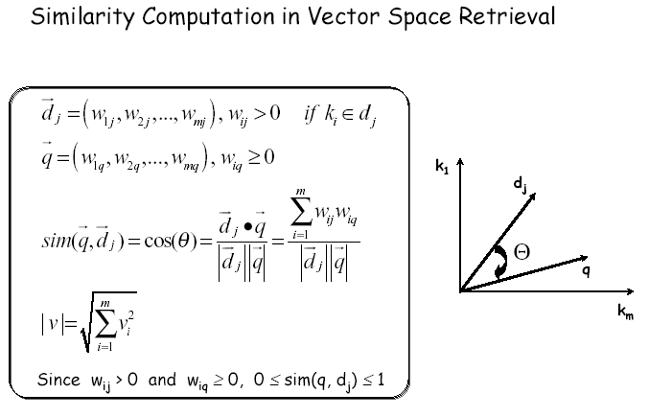
Notes:
The distance measure for vectors has to satisfy the following
properties:
•If two vectors coincide completely their similarity should be
maximal, i.e. equal to 1.
•If two vectors have no keywords in common, i.e. if wherever the
query vector has positive weights the document vector has
weight 0, and vice versa – or in other words if the vectors are
orthogonal – the similarity should be minimal, i.e. equal to 0.
•in all other cases the similarity should be between 0 and 1.
The scalar product (which is equivalent to the cosine of the angle
of two vectors) has exactly these properties and is therefore
(normally) used as similarity measure for vector space retrieval.

Slide 34
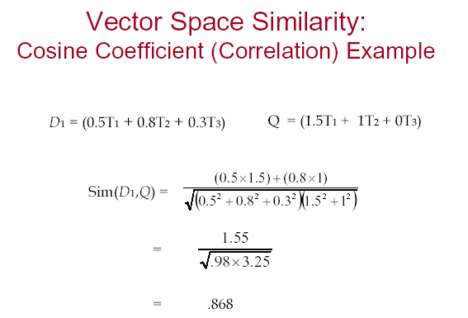

Slide 35
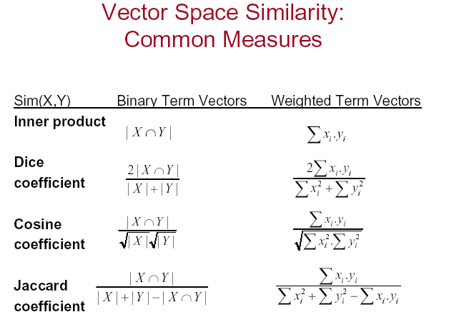

Slide 36
Queries as Vectors
Key idea 1: Do the same for queries: represent them as vectors in the space
Key idea 2: Rank documents according to their proximity to the query in this space
proximity = similarity of vectors
proximity ≈ inverse of distance
We do this because we want to get away from the you’re-either-in-or-out Boolean model.
Rank more relevant documents higher than less relevant documents

Slide 37
What is “Similarity” of Vectors?
Euclidean Distance (a dissimilarity measure!):
apple
orange
Limitation: very sensitive to word frequency!

Slide 38
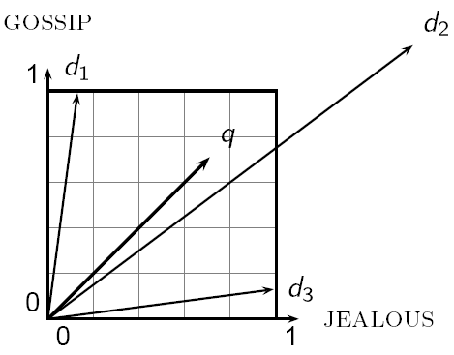
Why Distance is a Bad Idea
The Euclidean distance between q
and d₂ is large even though the
distribution of terms in the query q and the distribution of
terms in the document d₂ are
very similar.

Slide 39
Length Normalization
A vector can be (length-) normalized by dividing each of its components by its length – for this we use the L₂ norm:
Dividing a vector by its L₂ norm makes it a unit (length) vector
Effect on the two documents d and d′: they have identical vectors after length-normalization.

Slide 40
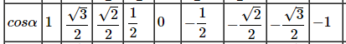
Cosine Similarity
The following two notions are equivalent.
Rank documents in increasing order of the angle between query and document
Rank documents in decreasing order of cosine(query, document)
Cosine is a monotonically decreasing function for the interval [0º, 180º]
Notes:
cos 0 = 1, cos 90 = 0, cos 180 = -1

Slide 41
What is “Similarity” of Vectors?
Cosine Similarity:
apple
Use angle between vectors instead of point distance to get around word frequency issues
orange

Slide 42
cosine(query, document)
Dot product
Unit vectors
q_{i} is the tf-idf weight of term i in the query
d_{i} is the tf-idf weight of term i in the document
cos(q,d) is the cosine similarity of q and d … or,
equivalently, the cosine of the angle between q and d.

Slide 43
Example: Similarity (SaS, PaP, WH)
How similar are the novels
SaS: Sense and Sensibility
PaP: Pride and Prejudice, and
WH: Wuthering Heights?
term | SaS | PaP | WH
affection | 115 | 58 | 20
jealous | 10 | 7 | 11
gossip | 2 | 0 | 6
wuthering | 0 | 0 | 38
Term frequencies (counts)

Slide 44
Example: Cosine Similarity (SaS, PaP, WH)
Log frequency weighting
After normalization
term | SaS | PaP | WH
affection | 3.06 | 2.76 | 2.30
jealous | 2.00 | 1.85 | 2.04
gossip | 1.30 | 0 | 1.78
wuthering | 0 | 0 | 2.58
term | SaS | PaP | WH
affection | 0.789 | 0.832 | 0.524
jealous | 0.515 | 0.555 | 0.465
gossip | 0.335 | 0 | 0.405
wuthering | 0 | 0 | 0.588
cos(SaS,PaP) ≈
0.789 ∗ 0.832 + 0.515 ∗ 0.555 + 0.335 ∗ 0.0 + 0.0 ∗ 0.0
≈ 0.94
cos(SaS,WH) ≈ 0.79
cos(PaP,WH) ≈ 0.69
Notes:
log 115 = 2.06 (base 10) Wt. = (1 + 2.06)

Slide 45
Weighting may Differ in Queries vs Documents
Many search engines allow for different weightings for queries vs documents
Example: ltn.lnc means:
Query: logarithmic tf (l in leftmost column), idf (t in second column), no normalization …
Document logarithmic tf, no idf and cosine normalization
Notes:
All query terms equally weighted wrt collection – stop words not supressed
(unless we expect the users not to enter them, or additional stop word filters to remove them)

Slide 46
tf-idf example: ltn.lnc
Document: car insurance auto insurance
Query: best car insurance
Term | Query |  |  |  |  | Document |  |  |  | Prod
 | tf-raw | tf-wt | df | idf | wt | tf-raw | tf-wt | wt | n’lized
auto | 0 | 0 | 5000 | 2.3 | 0 | 1 | 1 | 1 | 0.52 | 0
best | 1 | 1 | 50000 | 1.3 | 1.3 | 0 | 0 | 0 | 0 | 0
car | 1 | 1 | 10000 | 2.0 | 2.0 | 1 | 1 | 1 | 0.52 | 1.04
insurance | 1 | 1 | 1000 | 3.0 | 3.0 | 2 | 1.3 | 3.9 | 2.03 | 6.09
Notes:
Original slides have bugs here:
INSURANCE: term weight = (1 + log_10 2) = 1.3 idf = 3.0 wt = 1.3 *3 = 3.9
Normalization factor = sqrt(1+1+1.3^2) = sqrt(3.69) = 1.92
What is N?
log_10 (N/5000) = 2.3 N/5000 = 200 N = 10^6
verification(car): log_10(10^6/10^4) = 2

Slide 47
Summary – Vector Space Ranking
Represent the query as a weighted tf-idf vector
Represent each document as a weighted tf-idf vector
Compute the cosine similarity score for the query vector and each document vector
Rank documents with respect to the query by score
Return the top K (e.g., K = 10) to the user

Slide 48
Information Retrieval (word2vec, GloVe)
References:
N-Gram Language Models, Raymond J. Mooney
Approaches for Automatically Tagging Affect, Nathanael Chambers, Joel Tetreault, James Allen
word2Vec: http://deeplearning4j.org/word2vec
Tutorial and Visualization tool by Xin Rong (http://www-personal.umich.edu/~ronxin/pdf/w2vexp.pdf)
Word2vec in Gensim by Radim Řehůřek (http://rare-technologies.com/deep-learning-with-word2vec-and-gensim/)

Slide 49
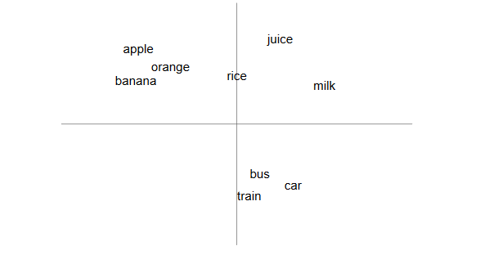
“A word is known by the company it keeps”

Slide 50
What is “Similarity” of Vectors?
Euclidean Distance (a dissimilarity measure!):
apple
orange
Limitation: very sensitive to word frequency!

Slide 51
What is “Similarity” of Vectors?
Cosine Similarity:
apple
Use angle between vectors instead of point distance to get around word frequency issues
orange

Slide 52
Building these magical vectors . . .
How do we actually build these super-intelligent vectors, that seem to have such magical powers?
How to find a word’s friends?
the most famous methods to build such lower-dimension vector representations for words based on their context
Co-occurrence Matrix with SVD
word2vec (Google)
Global Vector Representations (GloVe) (Stanford)

Slide 53
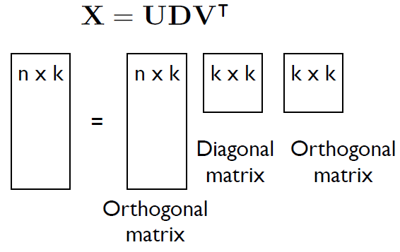
Co-occurrence Matrix with Singular Value Decomposition

Slide 54
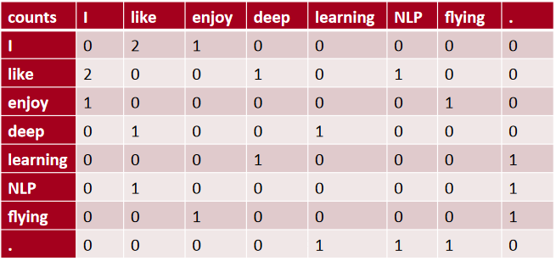
Building a Co-occurrence Matrix
Corpus = {“I like deep learning”
“I like NLP”
“I enjoy flying”}
Context = previous word and next word

Slide 55
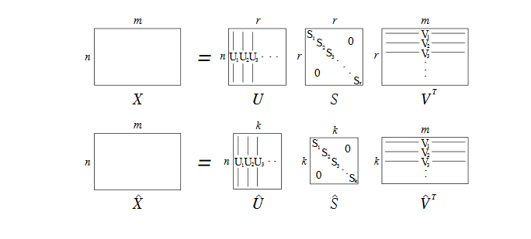
Dimension Reduction using Singular Value Decomposition (SVD)

Slide 56
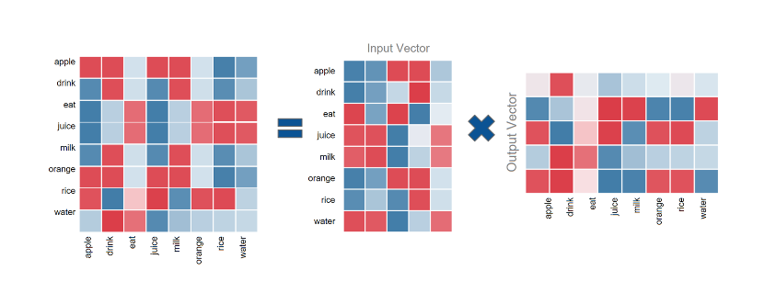
Singular Value Decomposition (SVD)
The problem with this method, is that we may end up with matrices having billions of rows and columns, which makes SVD computationally restrictive.

Slide 57
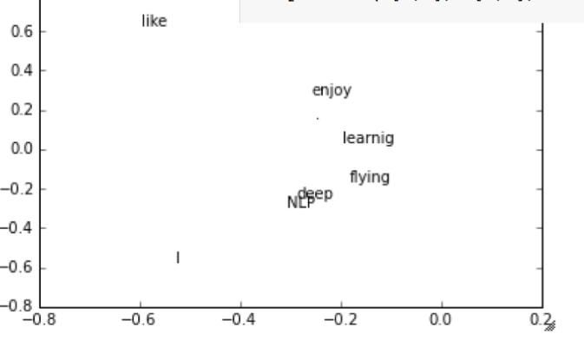
Outcomes: Singular Value Decomposition (SVD)

Slide 58

word2vec

Slide 59
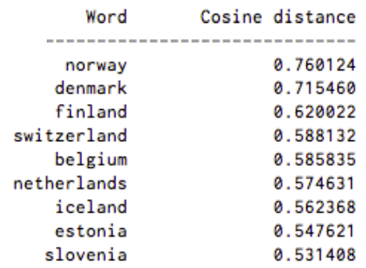
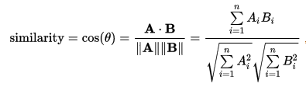
Word2Vec
A two-layer neural net that processes text.
Input is a text corpus
Output is a set of vectors: feature vectors for words in that corpus.
Not a deep neural network, but a numerical form that deep nets can understand
Measuring cosine similarity,
No similarity is expressed as a 90 degree angle,
Total similarity of 1 is a 0 degree angle
A list of words associated with “Sweden” using Word2vec, in order of proximity:

Slide 60
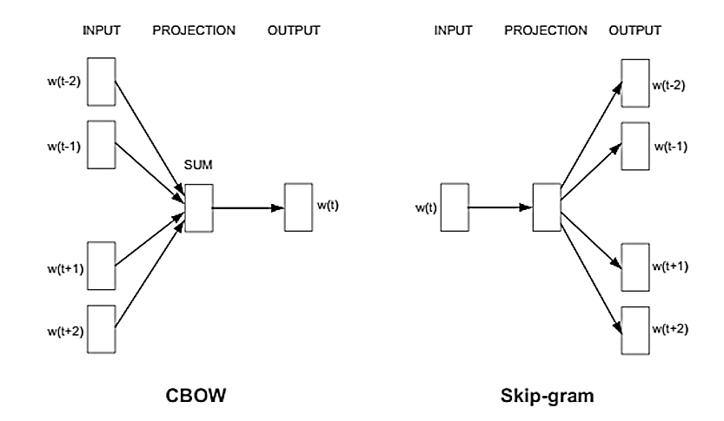
Word2Vec
Word2vec “vectorizes” about words for natural language computer-readable performing operations on words to detect their similarities.
Word2vec trains words against other words that neighbor them in the input corpus.
using context to predict a target word (a method known as continuous bag of words, or CBOW),
using a word to predict a target context, called skip-gram - more accurate results on large datasets.

Slide 61
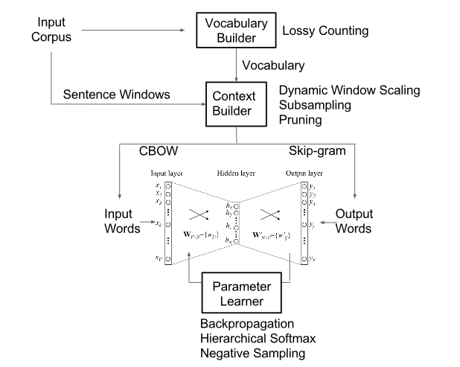
Architecture

Slide 62
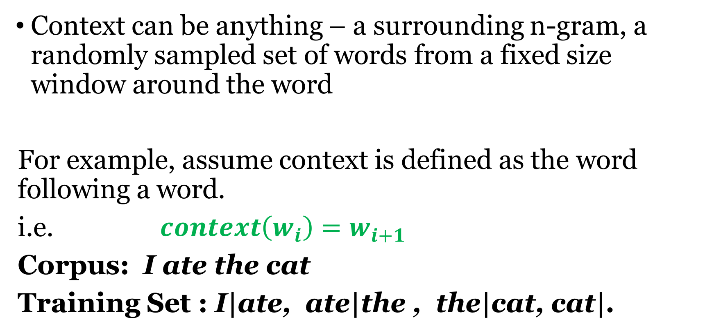
Context Windows
Context can be anything – a surrounding n-gram, a randomly sampled set of words from a fixed size window around the word
For example, assume context is defined as the word following a word.
i.e. $context\left(w_{i}\right)=w_{i+1}$
Corpus: I ate the cat
Training Set : I|ate, ate|the , the|cat, cat|.

Slide 63
Training Data
eat|apple
eat|orange
eat|rice
drink|juice
drink|milk
drink|water
orange|juice
apple|juice
rice|milk
milk|drink
water|drink
juice|drink
Concept :
Milk and Juice are drinks
Apples, Oranges and Rice can be eaten
Apples and Orange are also juices
Rice milk is a actually a type of milk!

Slide 64
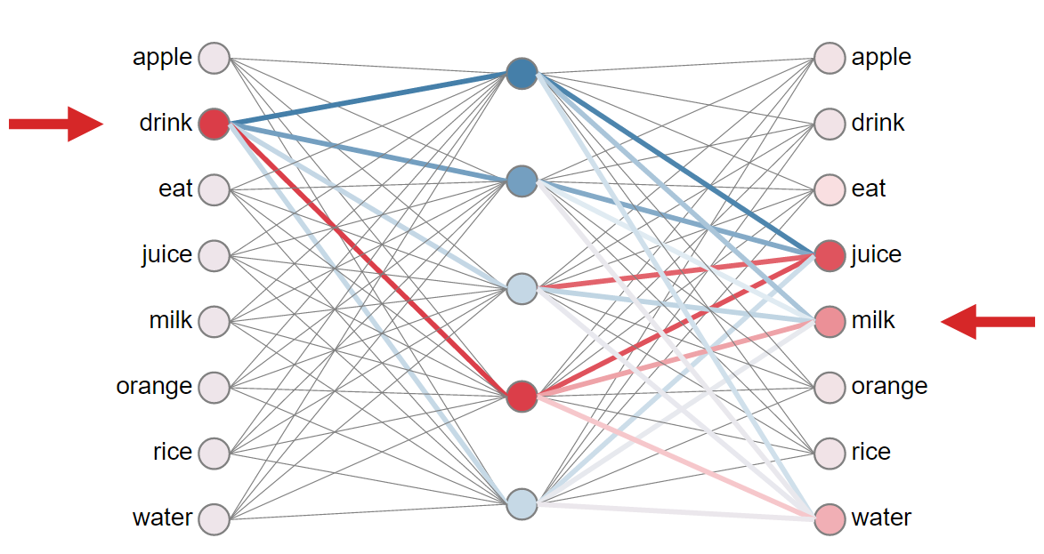

Slide 65
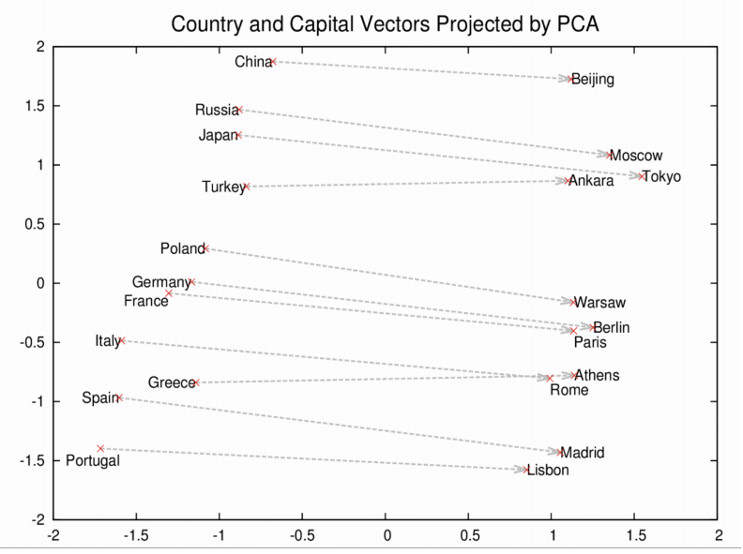
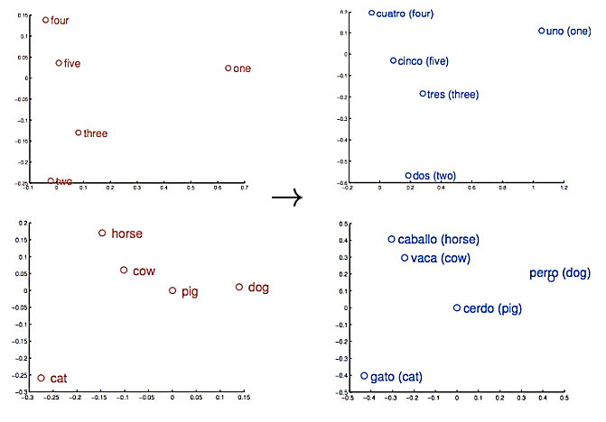
Word2Vec: Learning about Word Association
Case 1: Numbers
Case 2
Similarity is just the basis of many associations that Word2vec can learn. For example, it can gauge relations between words of one language, and map them to another.
If you only knew that Rome was the capital of Italy, and were wondering about the capital of China, then the equation Rome -Italy + China would return Beijing.

Slide 66

Word2Vec: Learning about Word Association
vector[Queen] = vector[King] - vector[Man] + vector[Woman]

Slide 67
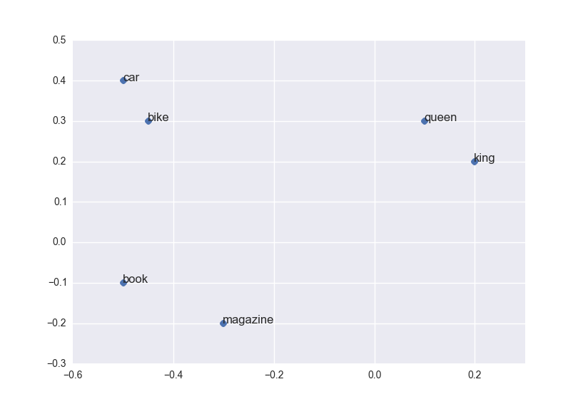

Slide 68

Global Vectors for Word Representation (GloVe)

Slide 69
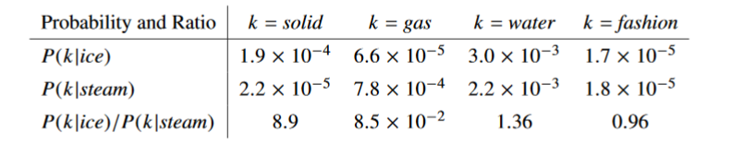
Global Vectors for Word Representation (GloVe)
Uses ratios of co-occurrence probabilities, rather than the co-occurrence probabilities themselves

Slide 70
Global Vectors for Word Representation (GloVe)
Global log-bilinear regression model for the unsupervised learning of word representations
This outperforms other models on some tasks like
word analogy,
word similarity, and
named entity recognition.

Slide 71
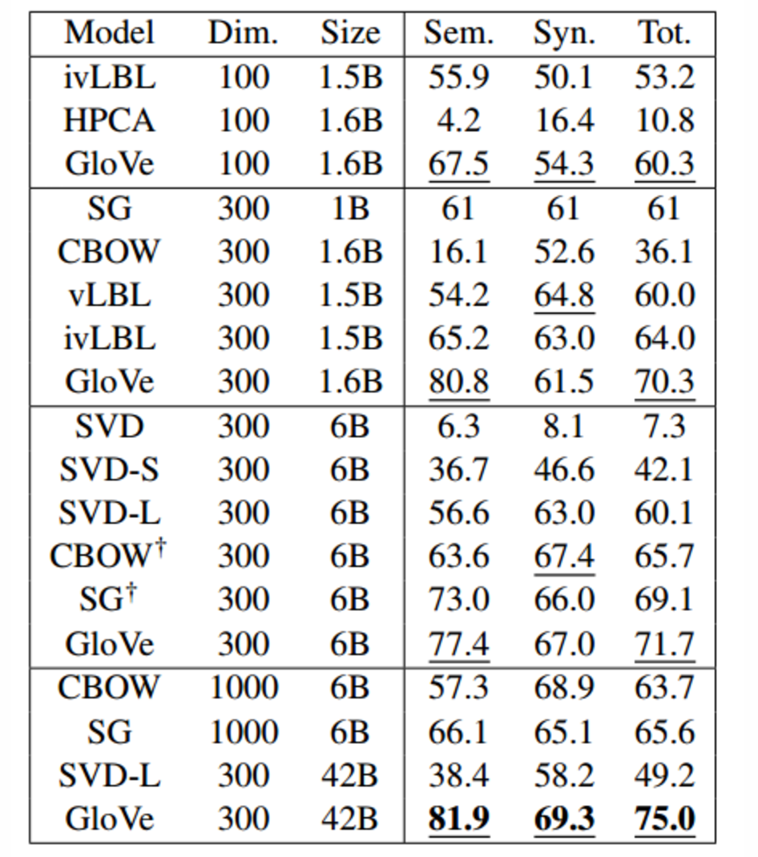
Word Analogy Task Results
Five corpora including
2010 Wikipedia dump with 1 billion tokens
2014 Wikipedia dump with 1.6 billion tokens,
Gigaword 5 with 4.3 billion tokens,
a combination of Gigaword 5 and the 2014 Wikipedia dump totalling 6 billion tokens,
42 billion tokens of web data from Common Crawl.
GloVe does very well on the word analogy task, achieving class-leading combined accuracy of 75%.
https://blog.acolyer.org/2016/04/22/glove-global-vectors-for-word-representation/

Slide 72
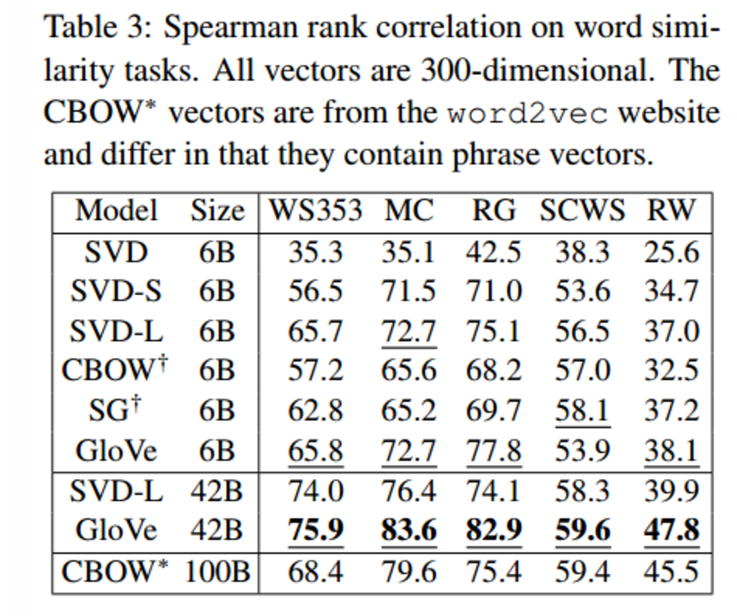
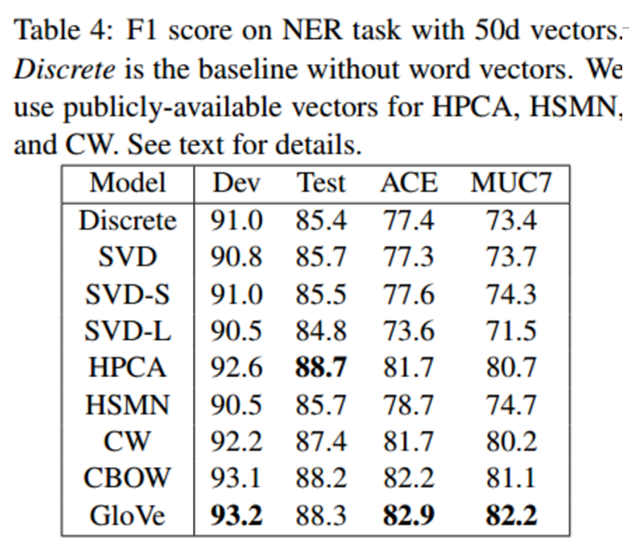
Word Similarity
Named Entity Recognition
https://blog.acolyer.org/2016/04/22/glove-global-vectors-for-word-representation/

Slide 73
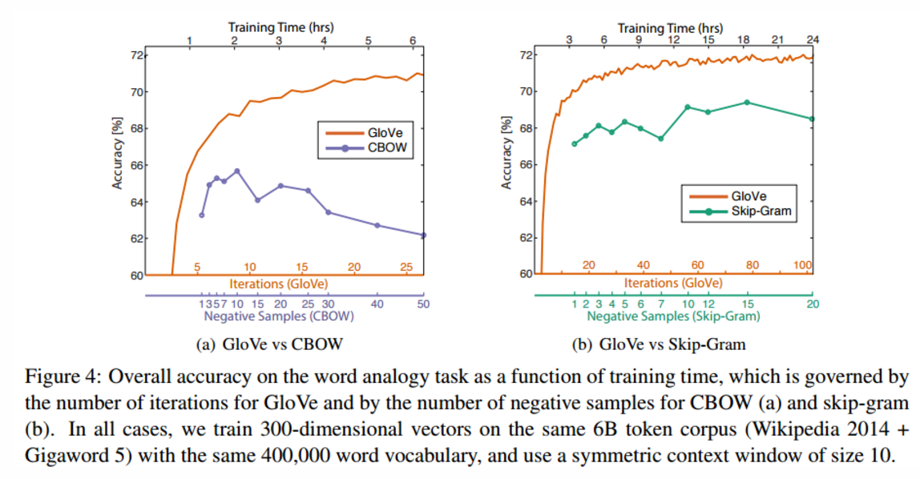
GloVe vs. CBOW/Skip-Gram
https://blog.acolyer.org/2016/04/22/glove-global-vectors-for-word-representation/

Slide 74
Applications of Word Vectors
Word Similarity
Classic Methods: Edit Distance, WordNet, Porter’s Stemmer, Lemmatization using dictionaries
Easily identifies similar words and synonyms since they occur in similar contexts
Stemming (thought -> think)
Inflections, Tense forms
eg. Think, thought, ponder, pondering,
eg. Plane, Aircraft, Flight

Slide 75
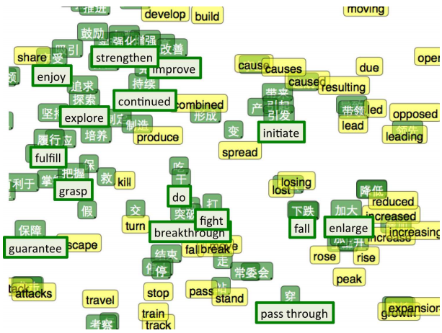
Applications of Word Vectors
2. Machine Translation
Classic Methods : Rule-based machine translation, morphological transformation

Slide 76
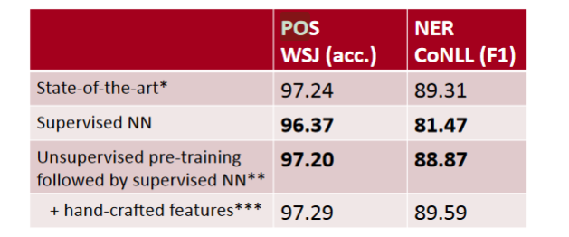
Applications of Word Vectors
3. Part-of-Speech and Named Entity Recognition
Classic Methods: Sequential Models (MEMM, Conditional Random Fields), Logistic Regression

Slide 77
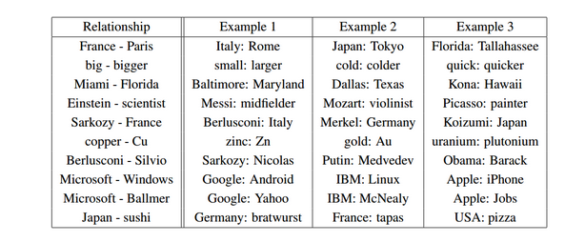
Applications of Word Vectors
4. Relation Extraction
Classic Methods : OpenIE, Linear programing models, Bootstrapping

Slide 78
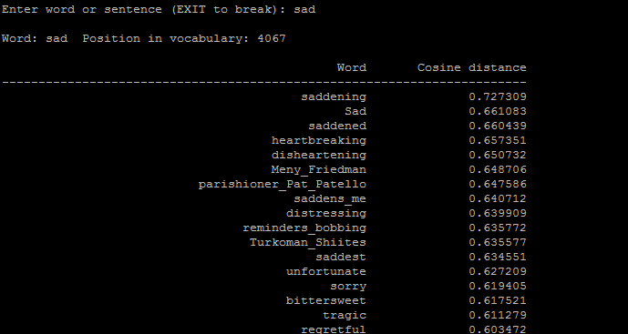
Applications of Word Vectors
5. Sentiment Analysis
Classic Methods : Naive Bayes, Random Forests/SVM
Classifying sentences as positive and negative
Building sentiment lexicons using seed sentiment sets
No need for classifiers, we can just use cosine distances to compare unseen reviews to known reviews.

Slide 79
Applications of Word Vectors
6. Co-reference Resolution
Chaining entity mentions across multiple documents - can we find and unify the multiple contexts in which mentions occurs?
7. Clustering
Words in the same class naturally occur in similar contexts, and this feature vector can directly be used with clustering algorithms (K-Means, HC agglomerative, EM, SOM).
8. Semantic Analysis of Documents
Build word distributions for various topics, etc.

Slide 80
Reference Materials
Deep Learning for NLP by Richard Socher (http://cs224d.stanford.edu/)
Tutorial and Visualization tool by Xin Rong (http://www-personal.umich.edu/~ronxin/pdf/w2vexp.pdf)
Word2vec in Gensim by Radim Řehůřek (http://rare-technologies.com/deep-learning-with-word2vec-and-gensim/)
Word2Vec Youtube Link:
https://www.youtube.com/watch?v=64qSgA66P-8

